Slide 1
WELCOME TO PYTHON
PYTHON is a high level and an object oriented programming language.
PYTHON language is used in a wide range of work .
For example :
Web Development
Software development
Scripting
AI/ML
Mathematics etc.
BENEFITS OF PYTHON OVER OTHER LANGUAGES
Can work across a range of different platforms (for eg. Linux , windows and MAC)
Easy syntax which is similar to the English language.
Automatic memory management.
No requirement of a compiler. PYTHON is a self interpreted language.
Shorter, more flexible codes
One doesn’t not need to specify the data types.

Slide 2
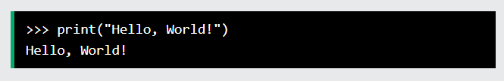
Execute Python Syntax
As we learned in the previous page, Python syntax can be executed by writing directly in the Command Line:
Or by creating a python file on the server, using the .py file extension, and running it in the Command Line:

Slide 3
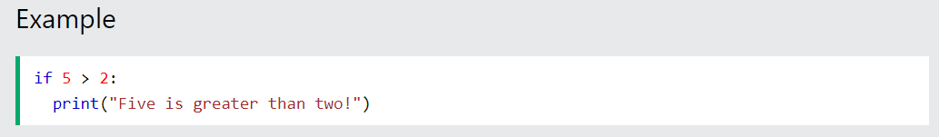
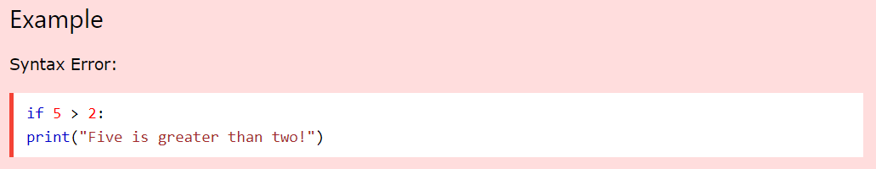
Python Indentation
Indentation refers to the spaces at the beginning of a code line.
Where in other programming languages the indentation in code is for readability only, the indentation in Python is very important.
Python uses indentation to indicate a block of code
Python will give you an error if you skip the indentation:

Slide 4
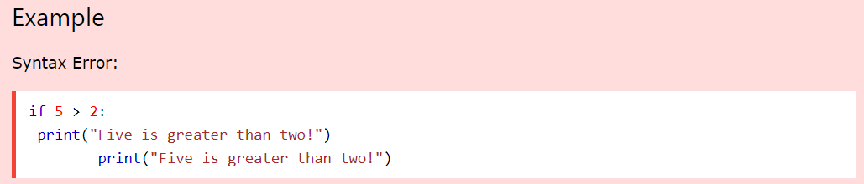
The number of spaces is up to you as a programmer, but it has to be at least one.
You have to use the same number of spaces in the same block of code, otherwise Python will give you an error:

Slide 5
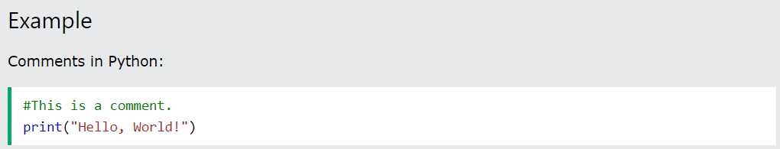
Comments
Python has commenting capability for the purpose of in-code documentation.
Comments start with a ‘#’ , and Python will render the rest of the line as a comment:
Comments can be used to explain Python code.
Comments can be used to make the code more readable.
Comments can be used to prevent execution when testing code.
Comments can be placed at the end of a line, and Python will ignore the rest of the line:

Slide 6
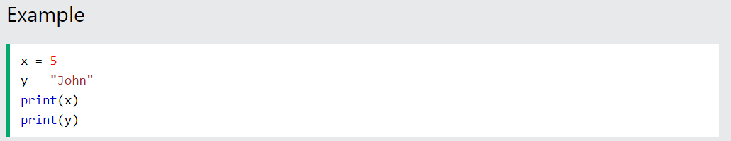
VARIABLES
Variables are containers for storing data values.
Creating Variables
Python has no command for declaring a variable.
A variable is created the moment you first assign a value to it.

Slide 7
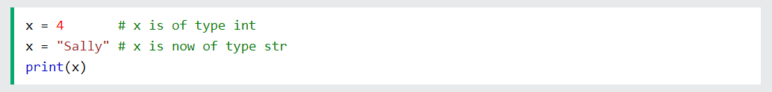
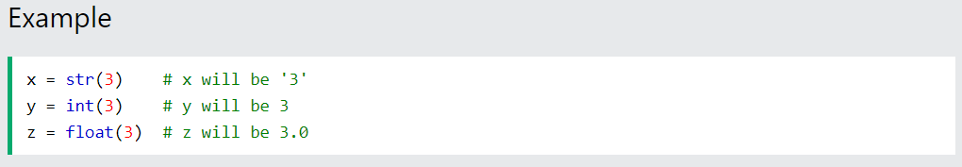
Variables do not need to be declared with any particular type, and can even change type after they have been set
Casting
If you want to specify the data type of a variable, this can be done with casting.

Slide 8
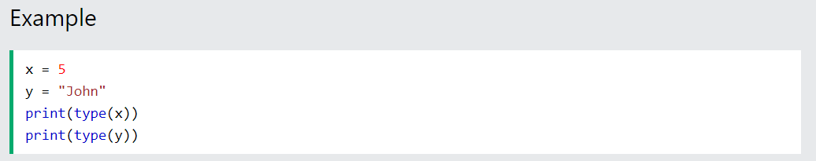
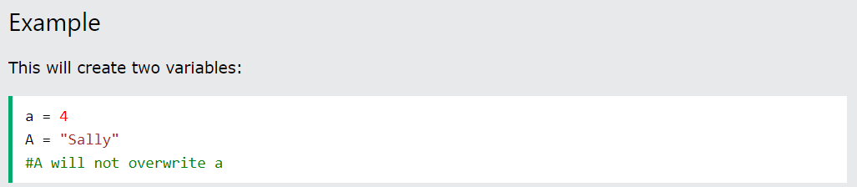
Get the Type
You can get the data type of a variable with the type() function.
Case-Sensitive
Variable names are case-sensitive.

Slide 9
Variable Names
A variable can have a short name (like x and y) or a more descriptive name (age, carname, total_volume).
Rules for Python variables :
A variable name must start with a letter or the underscore
( _ ) character.
A variable name cannot start with a number.
A variable name can only contain alpha-numeric characters and underscores (A-z, 0-9, and _ )
Variable names are case-sensitive (age, Age and AGE are three different variables)

Slide 10
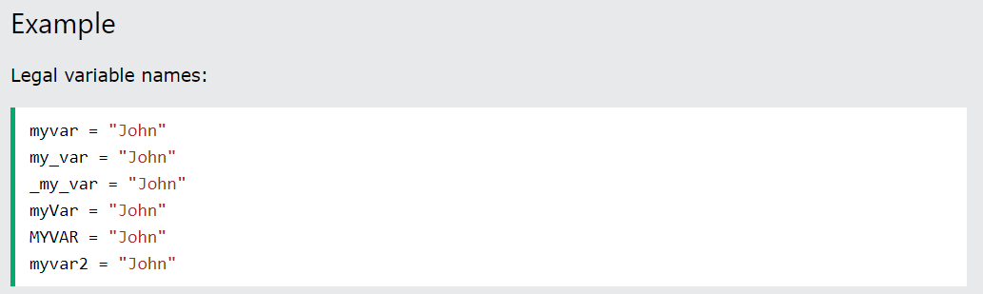
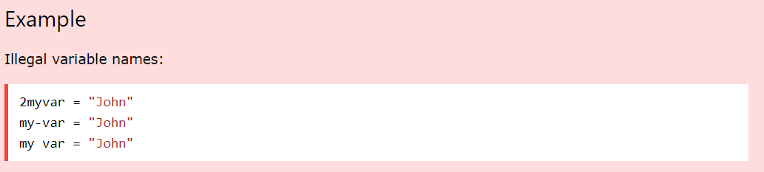

Slide 11
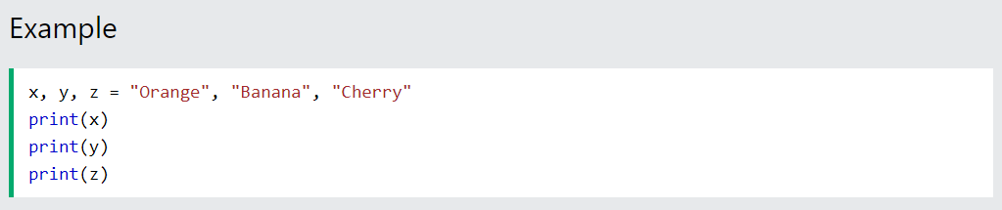
Python Variables - Assign Multiple Values
Many Values to Multiple Variables
Python allows you to assign values to multiple variables in one line:
Note: Make sure the number of variables matches the number of values, or else you will get an error.

Slide 12
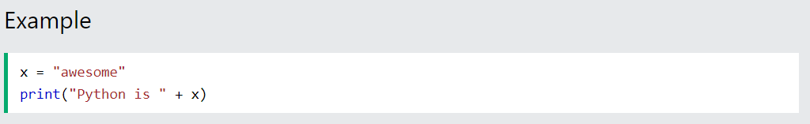
Output Variables
The Python print statement is often used to output variables.
To combine both text and a variable, Python uses the + character:
You can also use the + character to add a variable to another variable:
For numbers, the + character works as a mathematical operator:

Slide 13
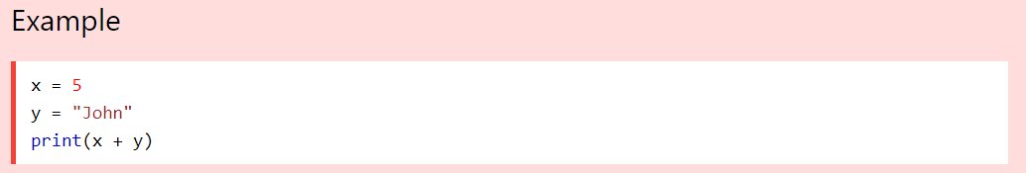
If you try to combine a string and a number, Python will give you an error:

Slide 14
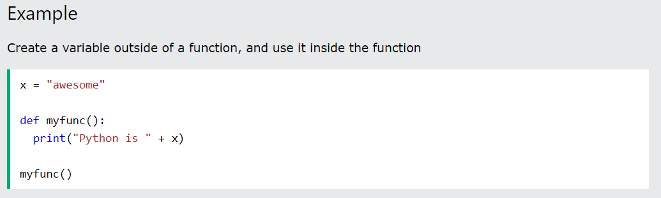
Global Variables
Variables that are created outside of a function (as in all of the examples above) are known as global variables.
Global variables can be used by everyone, both inside of functions and outside.

Slide 15
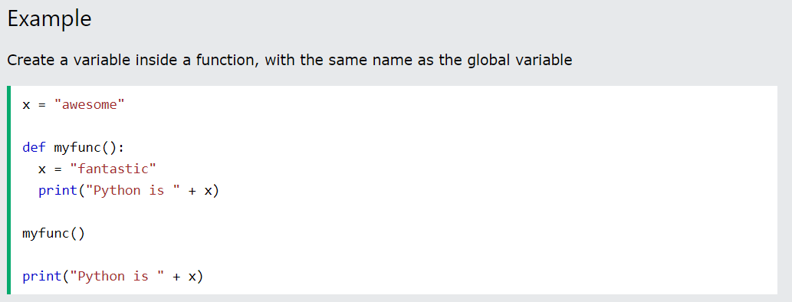
If you create a variable with the same name inside a function, this variable will be local, and can only be used inside the function. The global variable with the same name will remain as it was, global and with the original value.

Slide 16
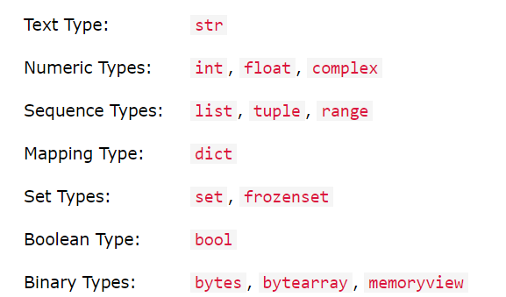
Python Data Types
Built-in Data Types
In programming, data type is an important concept.
Variables can store data of different types, and different types can do different things.
Python has the following data types built-in by default, in these categories:

Slide 17
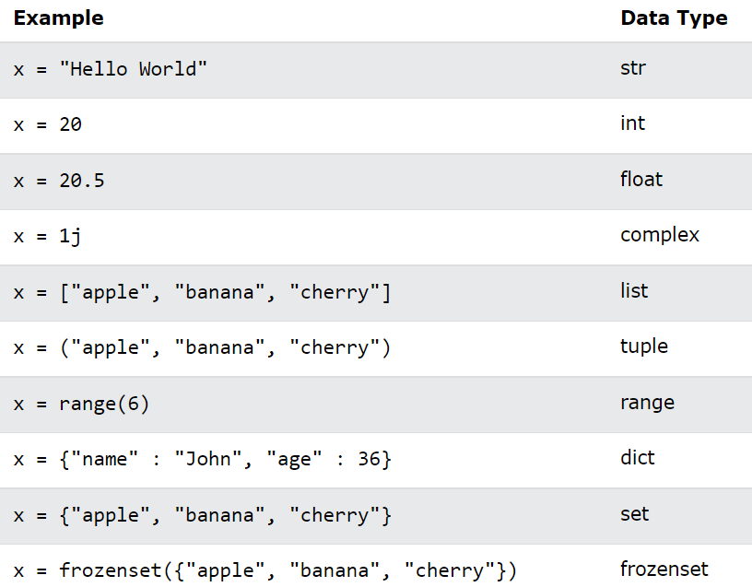
Setting the Data Type
In Python, the data type is set when you assign a value to a variable:

Slide 18
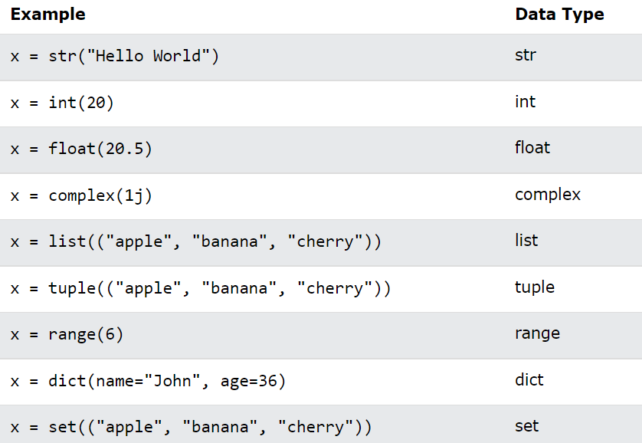
Setting the Specific Data Type
If you want to specify the data type, you can use the following constructor functions:

Slide 19
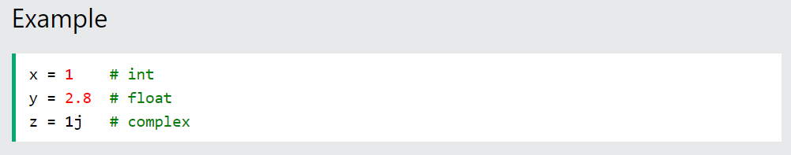
Python Numbers
There are three numeric types in Python:
int
float
complex
Variables of numeric types are created when you assign a value to them:

Slide 20
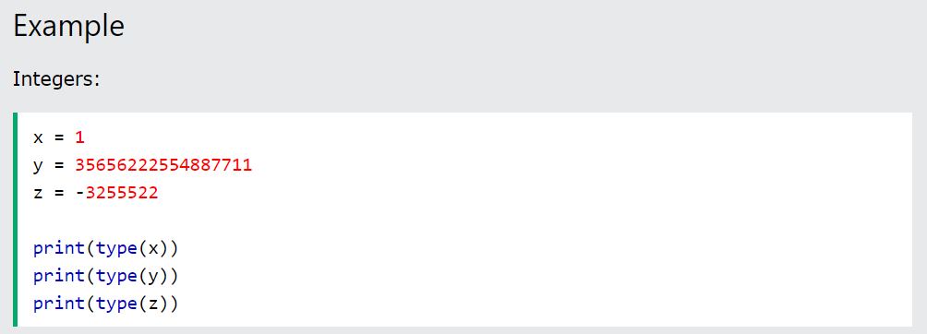
Int
Int, or integer, is a whole number, positive or negative, without decimals, of unlimited length.

Slide 21
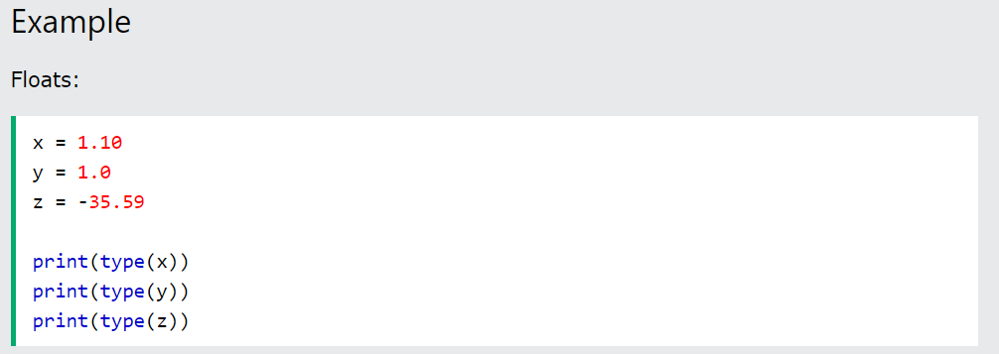

Float
Float, or "floating point number" is a number, positive or negative, containing one or more decimals.
Float can also be scientific numbers with an "e" to indicate the power of 10.
Example :

Slide 22
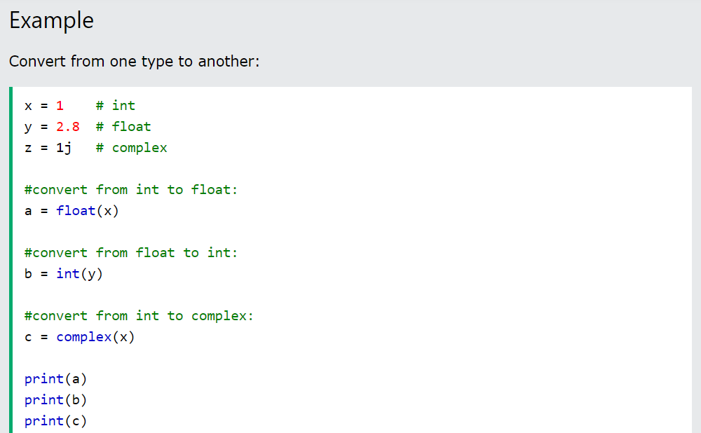
Type Conversion
You can convert from one type to another with the int(), float(), and complex() methods:

Slide 23
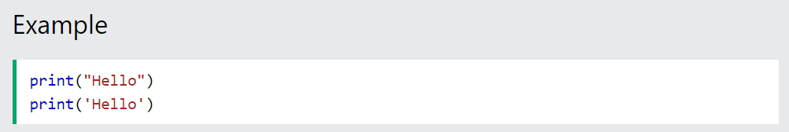
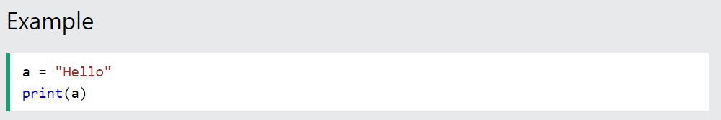
Strings in Python
A string is a sequence of characters. It can be declared in python by using double-quotes. Strings are immutable, i.e., they cannot be changed
Assign String to a Variable
Assigning a string to a variable is done with the variable name followed by an equal sign and the string:

Slide 24
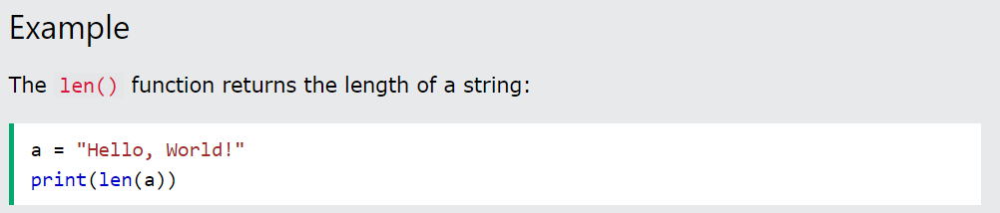
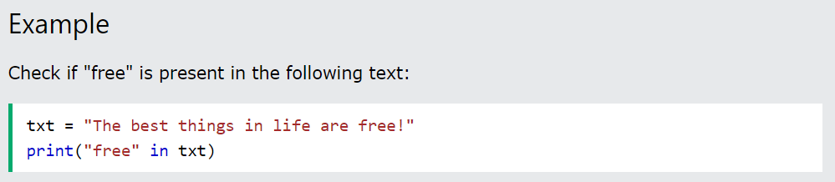
String Length
To get the length of a string, use the len() function.
Check String
To check if a certain phrase or character is present in a string, we can use the keyword in.

Slide 25
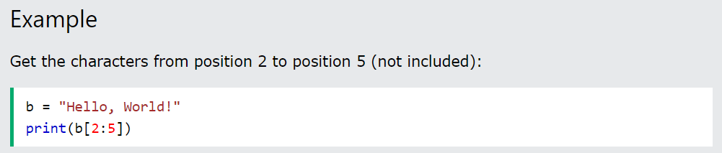
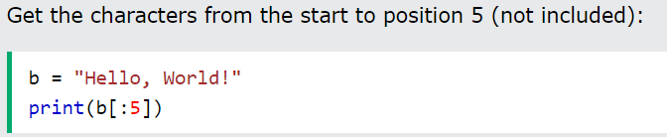
Slicing in strings
You can return a range of characters by using the slice syntax.
Specify the start index and the end index, separated by a colon, to return a part of the string.
Note: The first character has index 0
Slice From the Start
By leaving out the start index, the range will start at the first character:

Slide 26
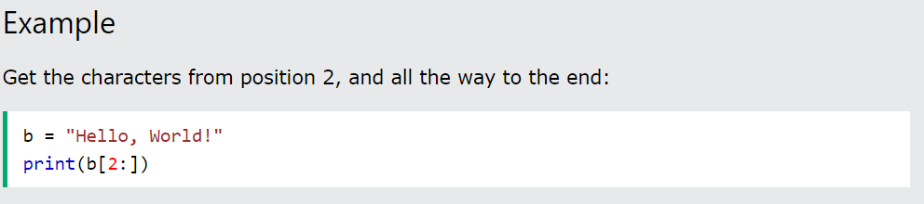
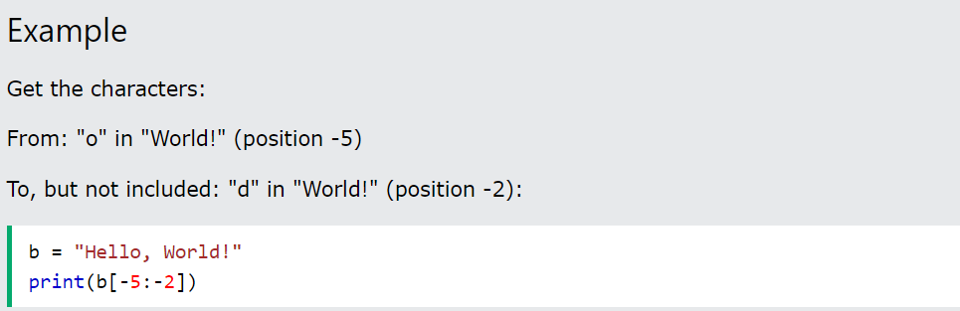
Slice To the End
By leaving out the end index, the range will go to the end:
Negative Indexing
Use negative indexes to start the slice from the end of the string:

Slide 27
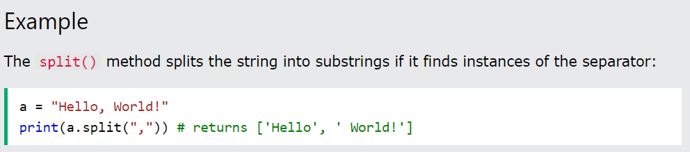
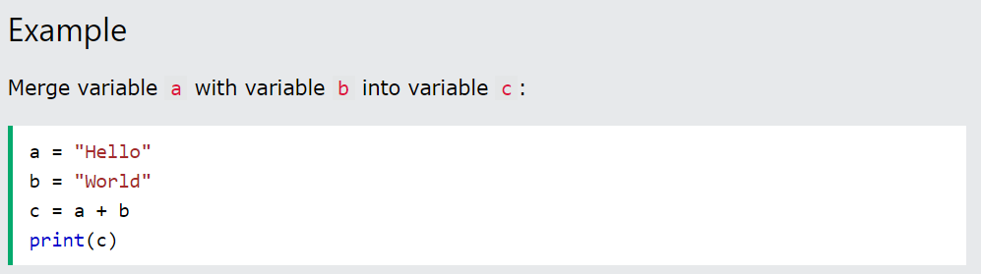
Split String
The split() method returns a list where the text between the specified separator becomes the list items.
String Concatenation
To concatenate, or combine, two strings you can use the + operator.

Slide 28
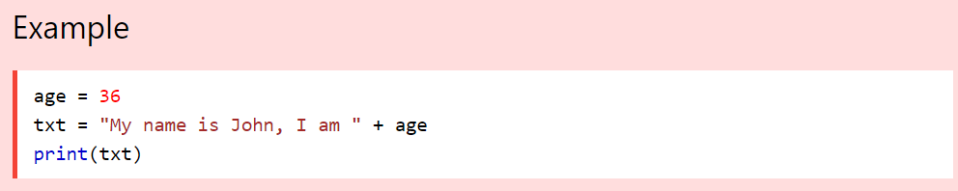
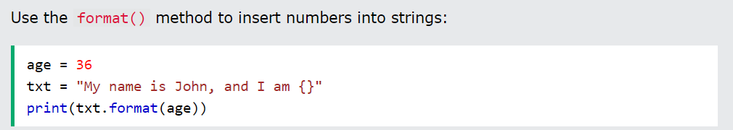
String Format
As we learned in the Python Variables chapter, we cannot combine strings and numbers like this:
But we can combine strings and numbers by using the format() method!
The format() method takes the passed arguments, formats them, and places them in the string where the placeholders {} are:
The format() method takes unlimited number of arguments, and are placed into the respective placeholders

Slide 29
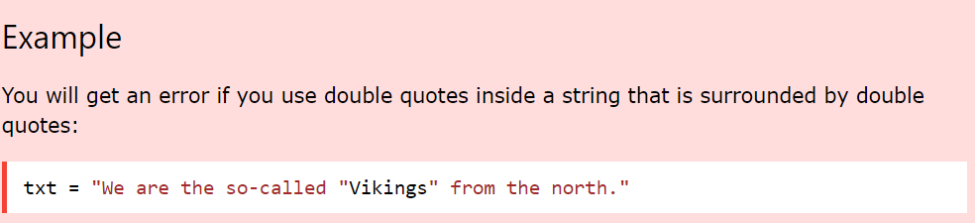
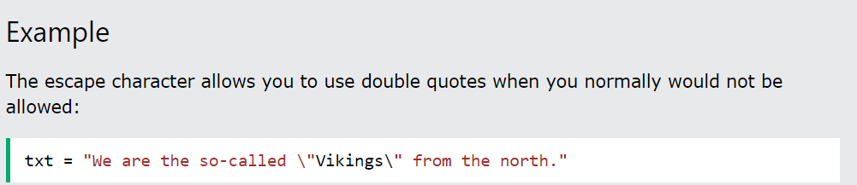
Escape Character
To insert characters that are illegal in a string, use an escape character.
An escape character is a backslash \ followed by the character you want to insert.
An example of an illegal character is a double quote inside a string that is surrounded by double quotes:
To fix this problem, use the escape character \":

Slide 30
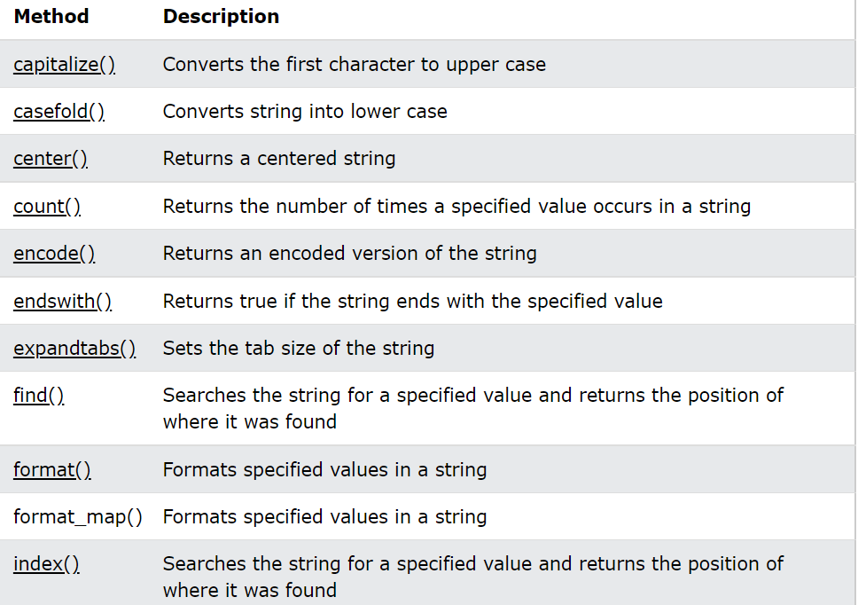
String Methods
Python has a set of built-in methods that you can use on strings.
Note: All string methods returns new values. They do not change the original string.

Slide 31
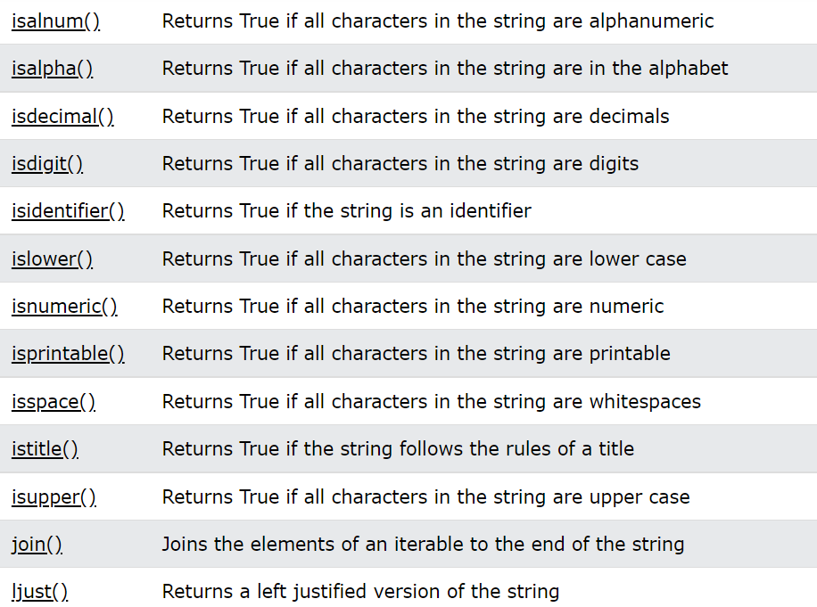

Slide 32
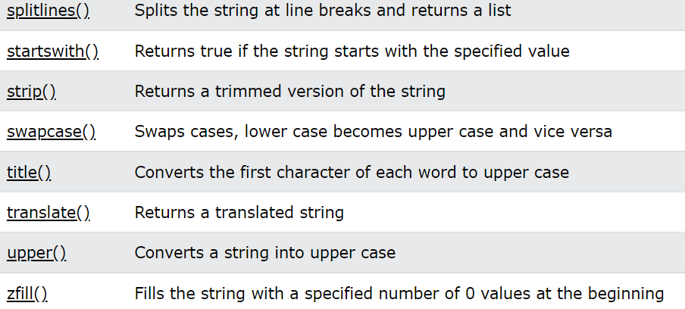

Slide 33
Escape Sequencing in Python
While printing Strings with single and double quotes in it causes Syntax Error because String already contains Single and Double Quotes and hence cannot be printed with the use of either of these. Hence, to print such a String either Triple Quotes are used or Escape sequences are used to print such Strings.
Escape sequences start with a backslash and can be interpreted differently. If single quotes are used to represent a string, then all the single quotes present in the string must be escaped and same is done for Double Quotes.

Slide 34
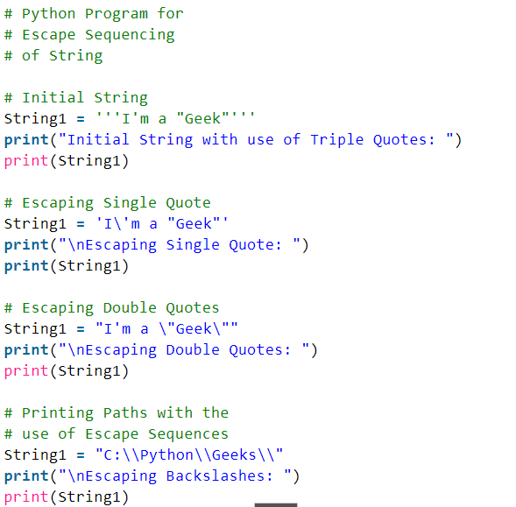

Slide 35
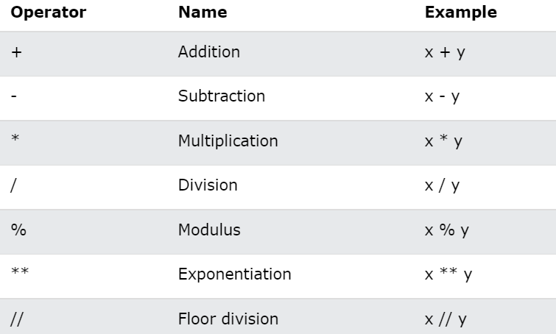
Python Operators
Operators are used to perform operations on variables and values.
In the example below, we use the + operator to add together two values:
Python Arithmetic Operators
Arithmetic operators are used with numeric values to perform common mathematical operations:

Slide 36
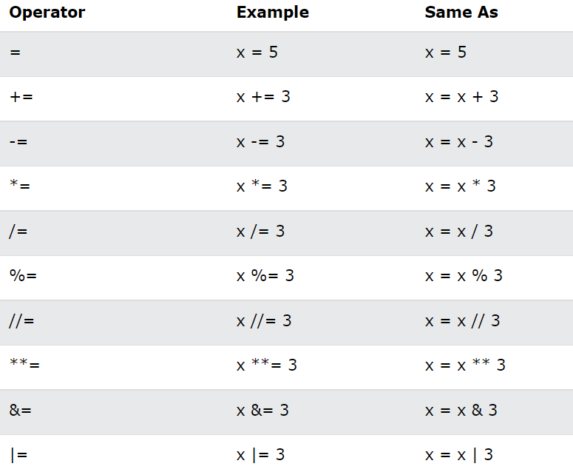
Python Assignment Operators
Assignment operators are used to assign values to variables:

Slide 37
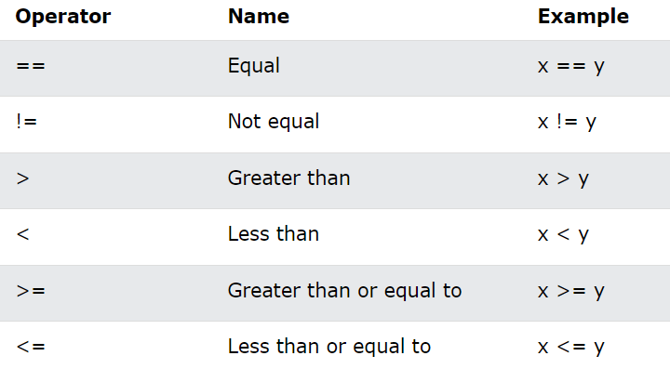
Python Comparison Operators
Comparison operators are used to compare two values:

Slide 38
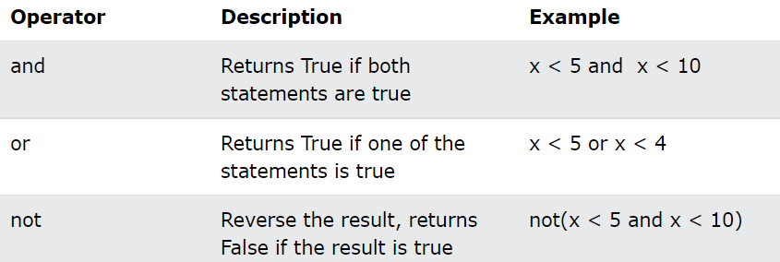
Python Logical Operators
Logical operators are used to combine conditional statements:

Slide 39
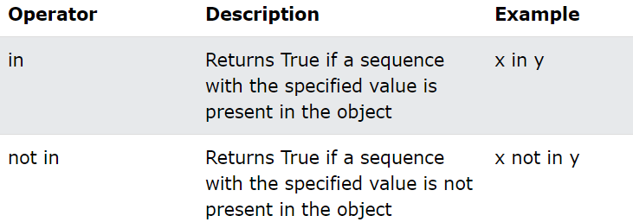
Python Membership Operators
Membership operators are used to test if a sequence is presented in an object:

Slide 40
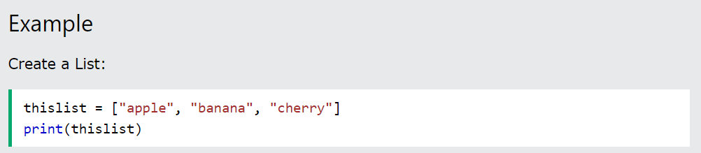
Python List
Lists are used to store multiple items in a single variable.
Lists are one of 4 built-in data types in Python used to store collections of data, the other 3 are Tuple, Set, and Dictionary, all with different qualities and usage.
Lists are created using square brackets:
List Items
List items are ordered, changeable, and allow duplicate values.
List items are indexed, the first item has index [0], the second item has index [1] etc.

Slide 41
Ordered
When we say that lists are ordered, it means that the items have a defined order, and that order will not change.
If you add new items to a list, the new items will be placed at the end of the list.
Note: There are some list methods that will change the order, but in general: the order of the items will not change.
Changeable
The list is changeable, meaning that we can change, add, and remove items in a list after it has been created.

Slide 42
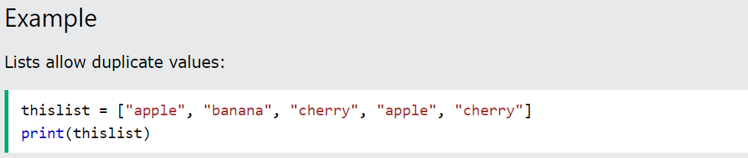
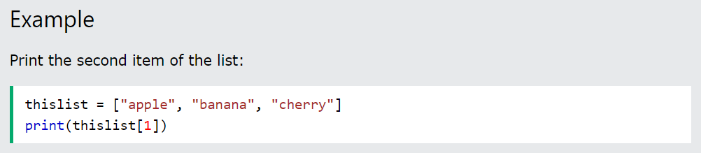
Allow Duplicates
Since lists are indexed, lists can have items with the same value:
Access Items
List items are indexed and you can access them by referring to the index number:
Note: The first item has index 0.

Slide 43


Negative Indexing
Negative indexing means start from the end
-1 refers to the last item, -2 refers to the second last item etc.
Range of Indexes
You can specify a range of indexes by specifying where to start and where to end the range.
When specifying a range, the return value will be a new list with the specified items.

Slide 44


By leaving out the start value, the range will start at the first item:
By leaving out the end value, the range will go on to the end of the list:

Slide 45


Change Item Value
To change the value of a specific item, refer to the index number:
Change a Range of Item Values
To change the value of items within a specific range, define a list with the new values, and refer to the range of index numbers where you want to insert the new values:

Slide 46

Note: The length of the list will change when the number of items inserted does not match the number of items replaced.
Insert Items
To insert a new list item, without replacing any of the existing values, we can use the insert() method.
The insert() method inserts an item at the specified index:
Append Items
To add an item to the end of the list, use the append() method:

Slide 47


Python - Add List Items
Append Items
To add an item to the end of the list, use the append() method:
Insert Items
To insert a list item at a specified index, use the insert() method.
The insert() method inserts an item at the specified index:

Slide 48

Extend List
To append elements from another list to the current list, use the extend() method.
The elements will be added to the end of the list.

Slide 49


Python - Remove List Items
Remove Specified Item
The remove() method removes the specified item.
Remove Specified Index
The pop() method removes the specified index.

Slide 50


The del keyword also removes the specified index:
Clear the List
The clear() method empties the list.
The list still remains, but it has no content.
Example

Slide 51

Python - Loop Lists
Loop Through a List
You can loop through the list items by using a for loop:

Slide 52

Using a While Loop
You can loop through the list items by using a while loop.
Use the len() function to determine the length of the list, then start at 0 and loop your way through the list items by refering to their indexes.
Remember to increase the index by 1 after each iteration.

Slide 53


Python - Sort Lists
Sort List Alphanumerically
List objects have a sort() method that will sort the list alphanumerically, ascending, by default:

Slide 54

Sort Descending
To sort descending, use the keyword argument reverse = True:
OUTPUT :

Slide 55


Case Insensitive Sort
By default the sort() method is case sensitive, resulting in all capital letters being sorted before lower case letters:
Reverse Order
What if you want to reverse the order of a list, regardless of the alphabet?
The reverse() method reverses the current sorting order of the elements.

Slide 56


Copy a List
You cannot copy a list simply by typing list2 = list1, because: list2 will only be a reference to list1, and changes made in list1 will automatically also be made in list2.
There are ways to make a copy, one way is to use the built-in List method copy().
Join Two Lists
There are several ways to join, or concatenate, two or more lists in Python.
One of the easiest ways are by using the + operator.

Slide 57

List Methods
Python has a set of built-in methods that you can use on lists.

